Slide 1

RAIN PREDICTION – Is there RAIN TOMORROW OR NOT?

Slide 2
Rainfall has a significant impact on planning our day’s for Festivals, all sorts of activities, and sports matches etc.
The goal of this project is to predict if it is going to rain the next day or not based on the weather measures of the day before
This creates a binary classification problem (1 = Rain and 0 = No Rain). The dataset consists of weather data in Australia over 10 years (1 Nov 2007 to 25 Jun 2017).
The dataset contains total 145460 rows and 23 columns
How Rain Tomorrow will be related to other features
Best and Effective Machine Learning algorithm for prediction

Slide 3
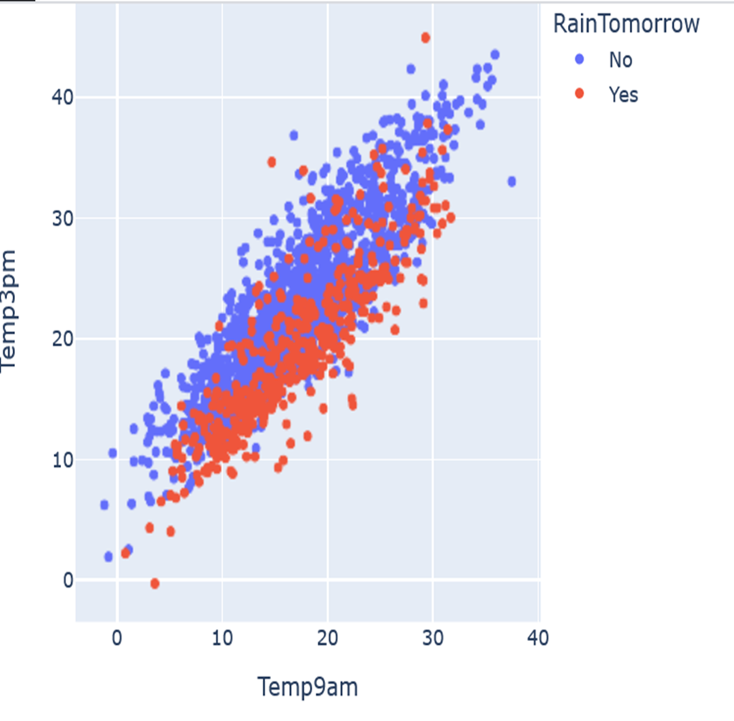
Both Temperatures are positively correlated.
High temperature results in no rain tomorrow.

Slide 4
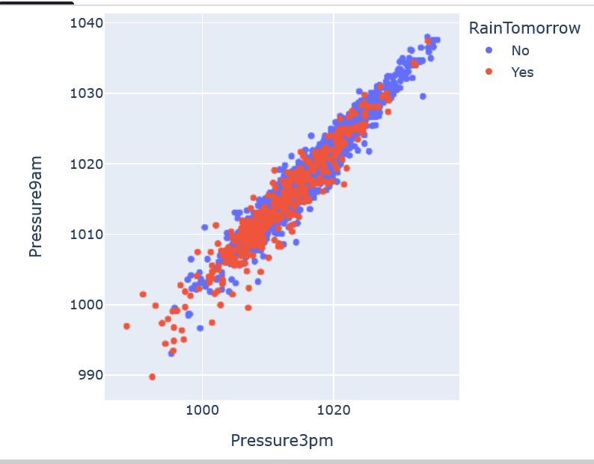
Pressure at 3PM is in a positive correlation with pressure at 9AM.
Since most of the points are overlapping, we can say that more pressure at 9AM and 3PM results in no rain tomorrow.

Slide 5
when evaporation value is at its maximum, rain is not observed the next day, it does not have much effect on Rain tomorrow
when sunshine is less, chances of getting rain is more
Windgustspeed, if very high, then surely chances of rain tomorrow
Windspeed9am doesn't seem to have much effect on Rain tomorrow as even if it is high, there is almost equal chance for it to rain
Windspeed3pm if very high, then rain occurs
More chances of rain when humidity is very high
When cloud value is very high, less chances of getting rain tomorrow

Slide 6
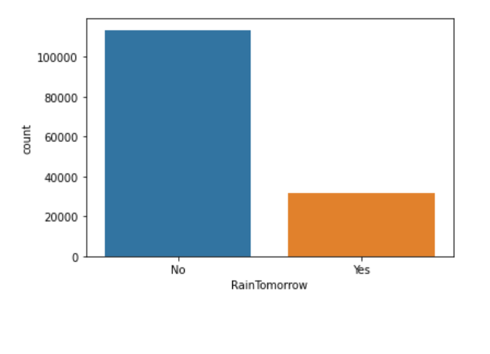
Analysis of Target Variable

Slide 7
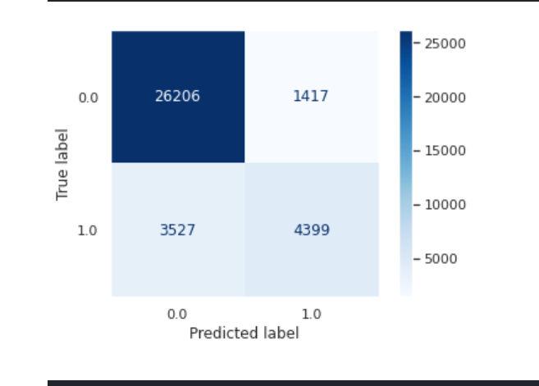
XGB CLASSIFIER –EVALUATION RECOMMENDATIONS
From matrix, we can analyze the model as
True positive: 26206 times o NO RAIN TOMORROW were predicted correctly by the model.
False-positive: 1417 times wrongly predicted as a RAIN TOMORROW
False-negative: 3527 times were wrongly predicted as NO RAIN TOMORROW.
True Negative: 4399 times RAIN TOMORROW were predicted correctly by the model.

Slide 8
Test Accuracy, Precision, Recall rates are higher than other models
Less overfitting compared to other models
Predicting time is less compared to other models –more faster
False positive(TYPE1) and False negative(TYPE 2) rates are less
Australia become hotter from 2017 to 2019,and from 2019 to 2022, it became stable also some weather metrics have been changed in these years so availability of these 5 years data will be helpful to predict Rain accurate .

Slide 9
Thank you
JOBIN JOSE
jjobin9660@gmail.com
Github: https://github.com/JobinJose9660/Rain-Prediction/blob/main/Rain_Prediction.ipynb

